Slide 1
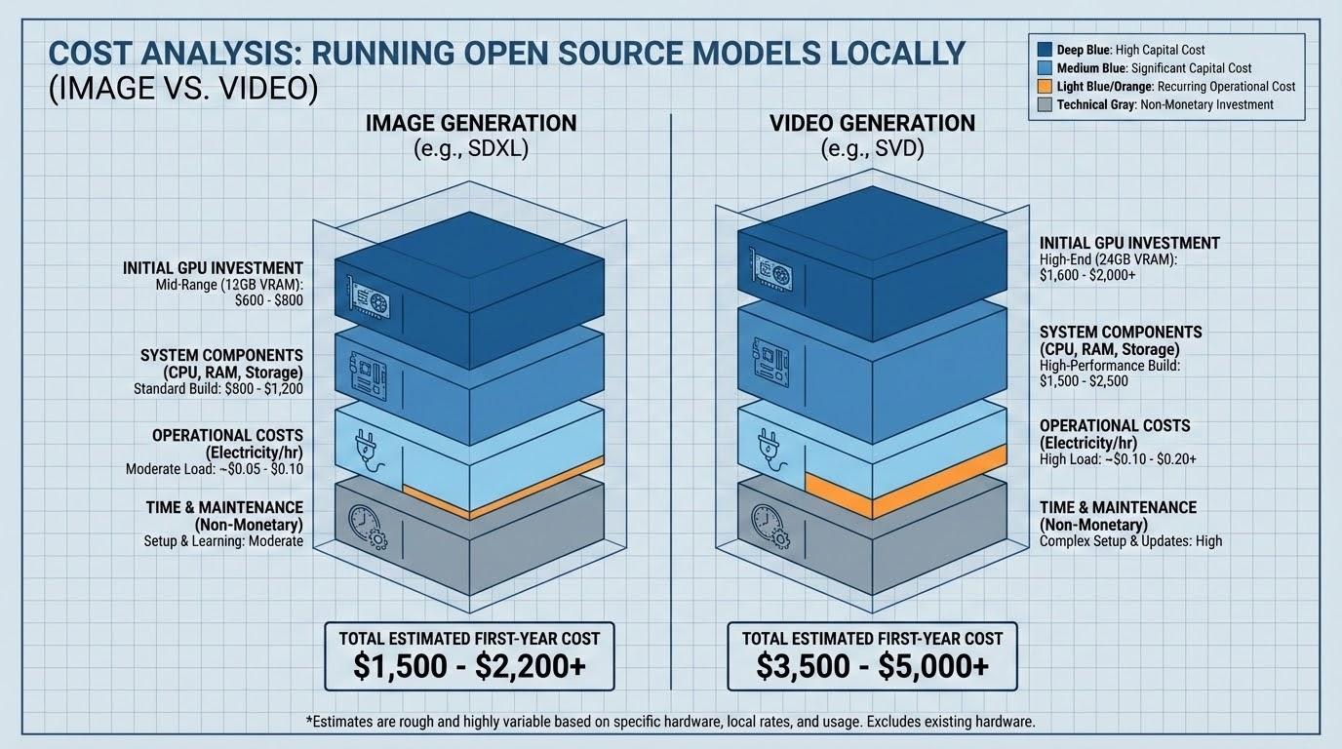

Slide 2
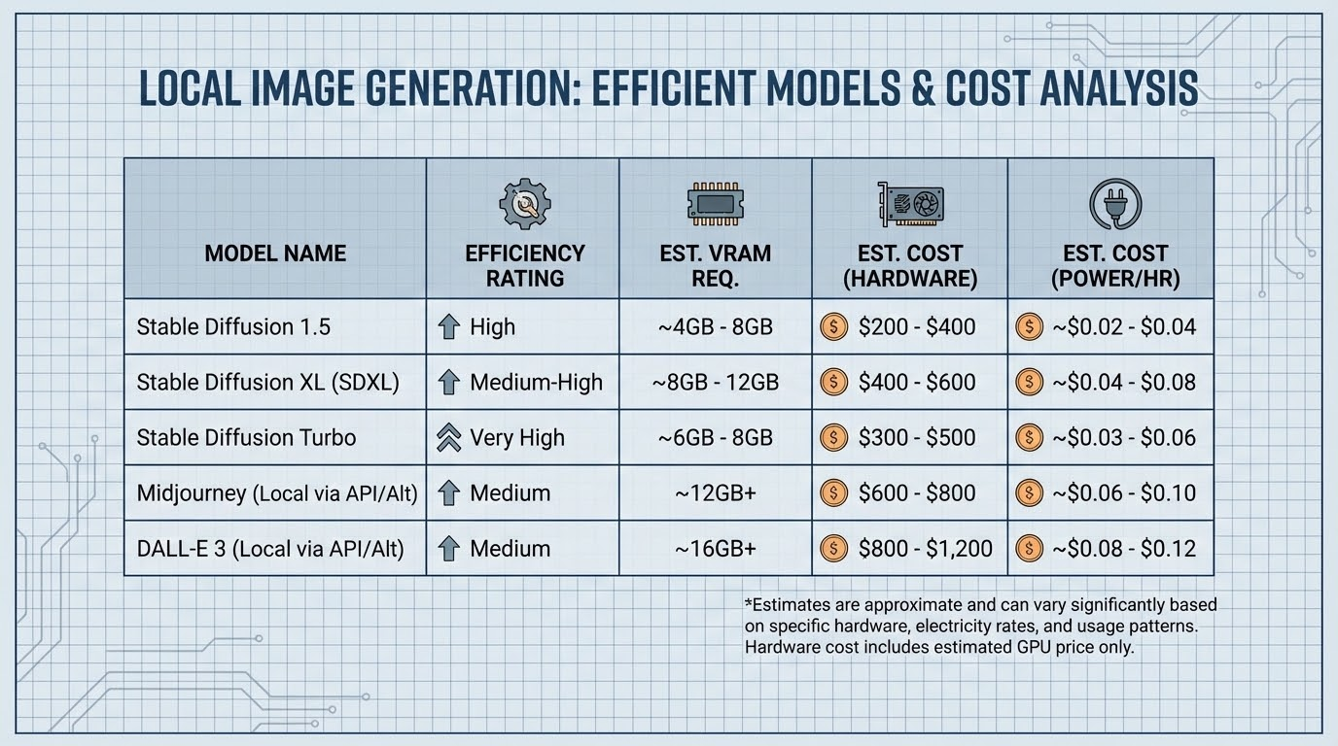

Slide 3
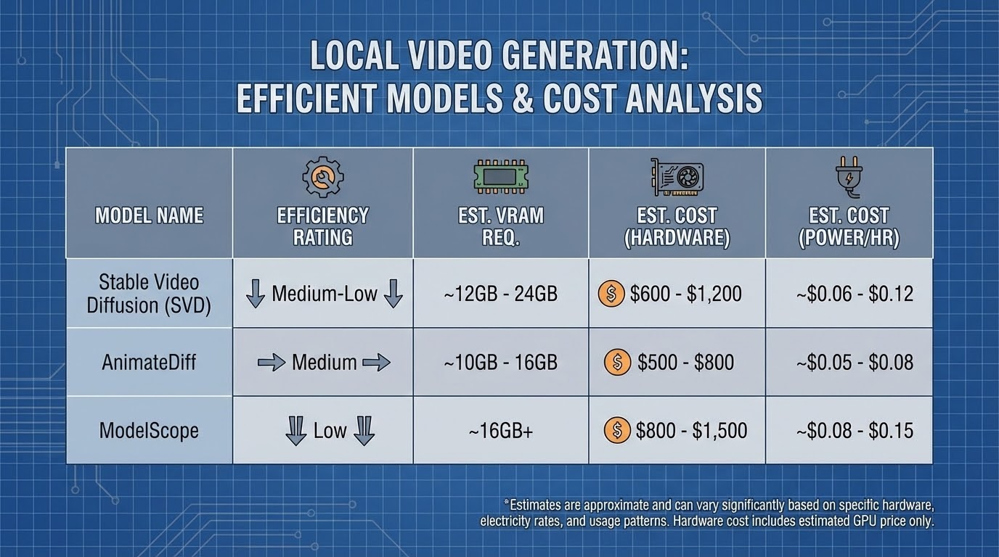

Slide 4
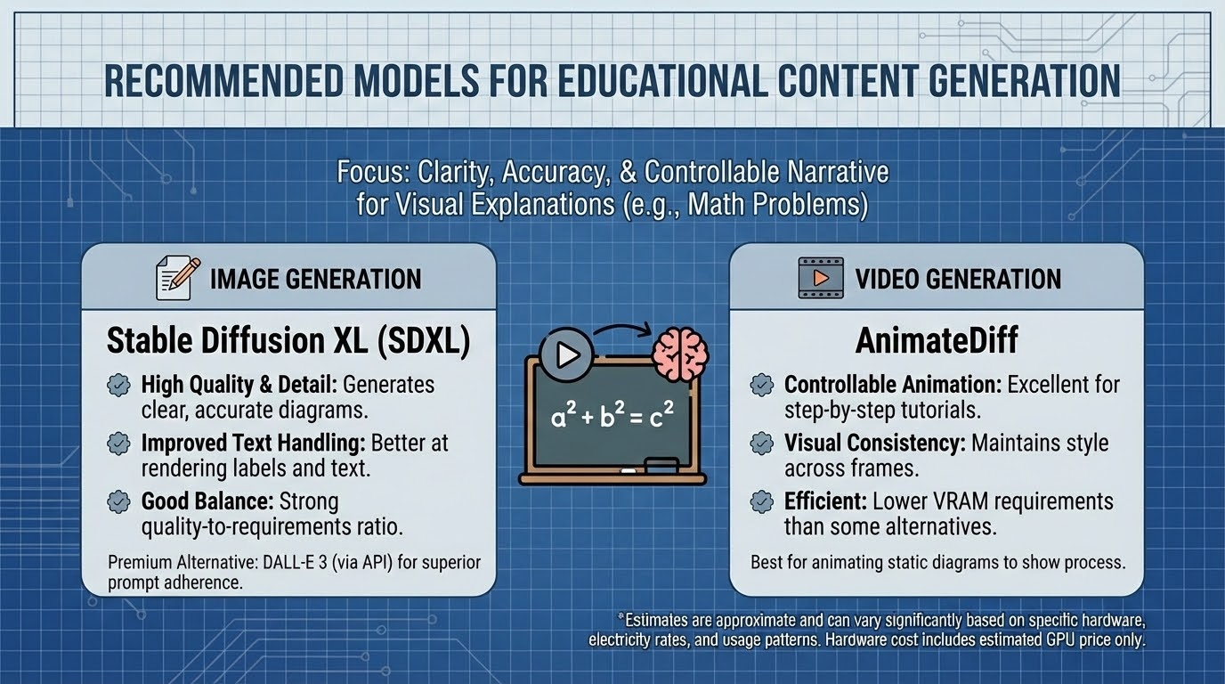

Slide 5
Animation Generation Analysis:
Why Adobe Firefly Stands Out
Strong industry partnerships
→ Integrates tools from Google, OpenAI/Sora, Runway, Pika, Luma & more.
All-in-one workflow
→ Use Adobe and external AI models in one place.
Single credit-based payment system → Same credits work across different AI models.
Free trials + unified subscriptions → One plan can cover multiple generation tools.
Supports full media creation → Images, animation, video, and audio in the same platform.
Better cost control → Users can switch models based on quality vs budget needs.

Slide 6
Firefly Creative Flexibility — Supported Models Overview
- Firefly acts as a single hub combining top AI image + video ecosystems.
Provider
Image Models
Video Models
Key Advantage
Adobe
Firefly Image 5, 4 Ultra, 4, 3
Firefly Video Model
Native integration, stable quality, commercial-safe output
OpenAI
GPT Image 1.5, GPT Image 1
Sora 2
Strong realism, creative scene generation
Google
Gemini 3 / 2.5 (Nano Banana), ImageGen 4, ImageGen 3
Veo 3.1, Veo 3.1 Fast, Veo 2
High detail visuals, fast + low-cost video options
Runway
Runway Gen-4 Image
Runway Gen-4.5
Stylized motion and cinematic composition
Luma
—
Ray 3.14, Ray 3.14 HDR, Ray 3, Ray 3 HDR, Ray 2
Cinematic HDR realism and lighting quality
Pika
—
Pika 2.2
Strong reflections, textures, and visual realism
Flux / Ideogram
Flux Point 2 Pro, Flux Point 1 Context Max, Flux 1 Pro Ultra Raw, Flux 1 Pro Ultra, Ideogram 3.2
—
High-quality image styling and composition control

Slide 7
Adobe Firefly — Complete Cost Analysis
Subscription Plans & Pricing [Ref: https://www.adobe.com/products/firefly/plans.html]
Firefly Standard — $9.99/month [2,000 generative credits per month]
Firefly Pro — $19.99/month [4,000 generative credits per month]
Firefly Premium — $199.99/month [50,000 generative credits per month]
Creative Cloud Pro — ~$69.99/month [4,000 generative credits per month]
One shared credit pool used for images, video, audio, and partner models.
Credit usage depends on model type, resolution, and feature.
Credits reset monthly and do not roll over.
Firefly Native Video Credit Usage
Partner Model Credit Consumption (per sec)
Overall Cost Efficiency Insight
1080p video: ~100 credits per second.
720p video: ~50 credits per second.
540p video: ~20 credits per second.
Audio translation & lip-sync: ~5–15 credits per second.
Higher resolution → higher credit cost.
Veo 3.1 Fast: ~10 credits/sec.
Runway Gen-4: ~20–40 credits/sec.
Pika 2.2: ~25–50 credits/sec.
Veo 3.1: ~50 credits/sec.
Sora 2: ~30 credits/sec (90 for Pro).
Luma Ray HDR / high-res HDR: up to hundreds of credits/sec
Firefly combines multiple AI models under one subscription.
Users can switch models based on budget vs quality.
Credit system enables fine-grained cost control per second of video

Slide 8
Other Notable AI Animation & Video Tools
Animaker AI → Focus on storyboard-driven animation and multi-scene storytelling.
Runway → Strong stylized video and motion generation outside Firefly.
Neural Frames → AI-assisted music-driven animation and visual sequencing.
Gen-2 / experimental animation tools → Research-focused cinematic generation workflows.
GUI-based AI video editors → Simplified drag-and-drop animation creation for beginners.

